Slide 1
Self-Service Registration
Guide to Online Registration

Slide 2
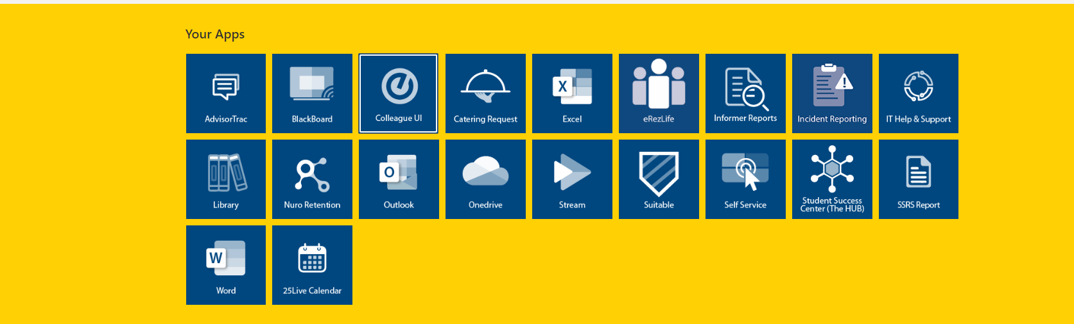
Log Into My NU- Click on the Self-Service Tab

Slide 3
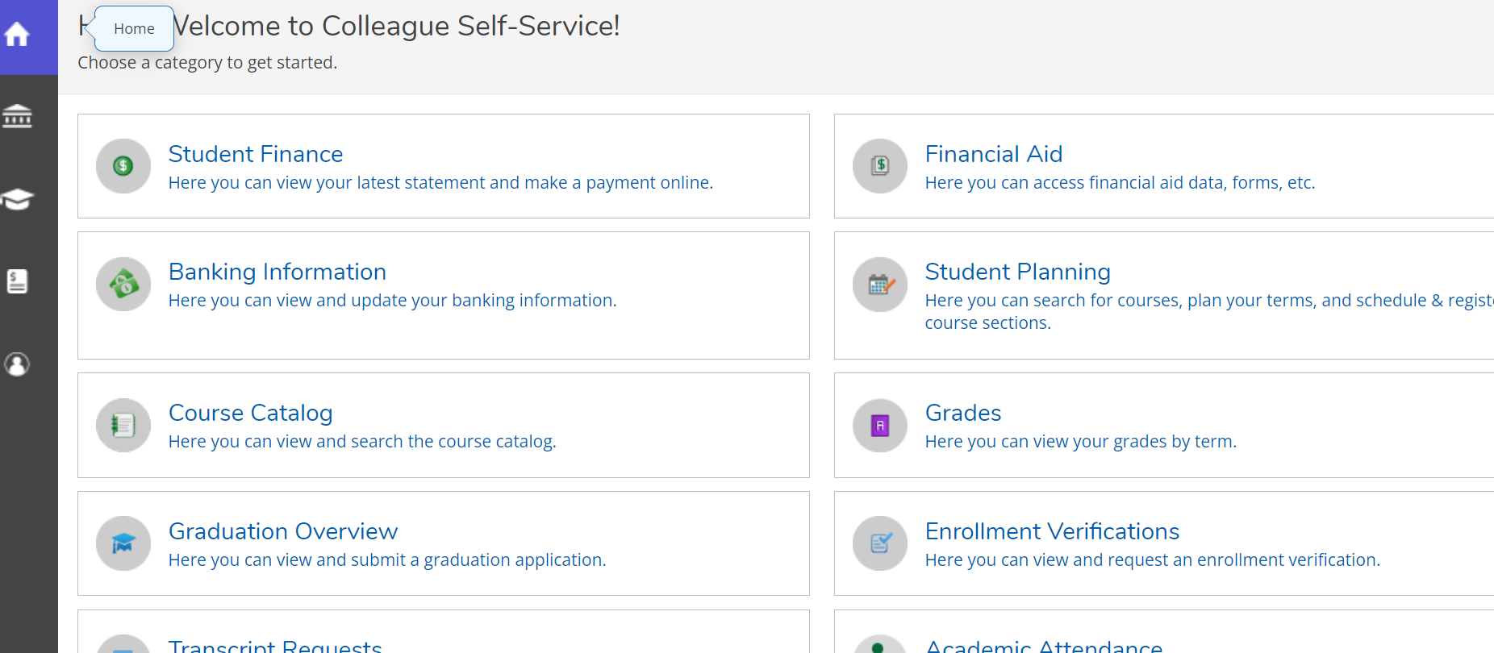
Click on the Cap on the left-hand side menu

Slide 4
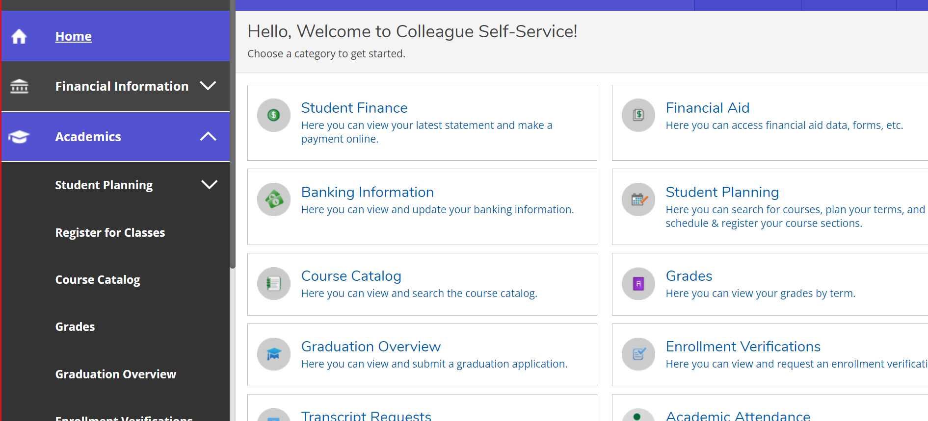
The Cap Icon will display all Academic Tabs- Click on Register for Classes

Slide 5
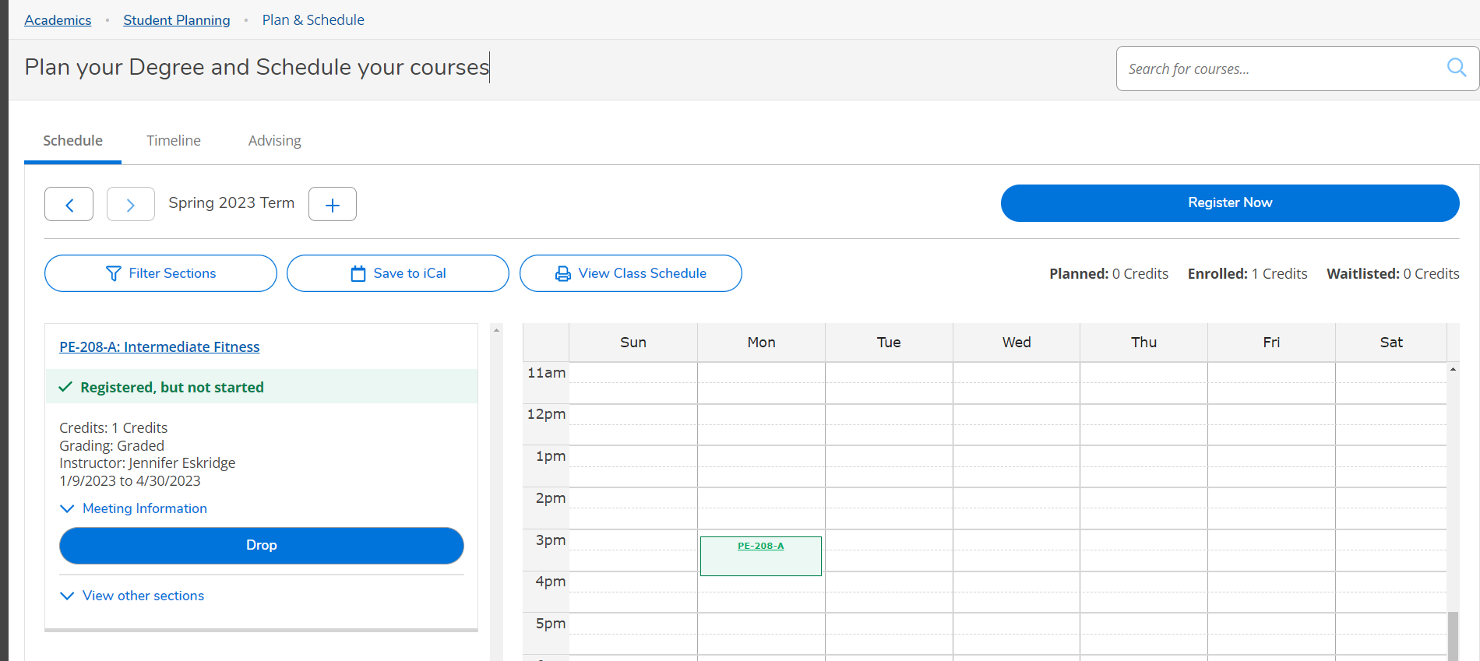
The Student’s current classes will be displayed below. Students have access to their academic plan and advisor contact information.

Slide 6
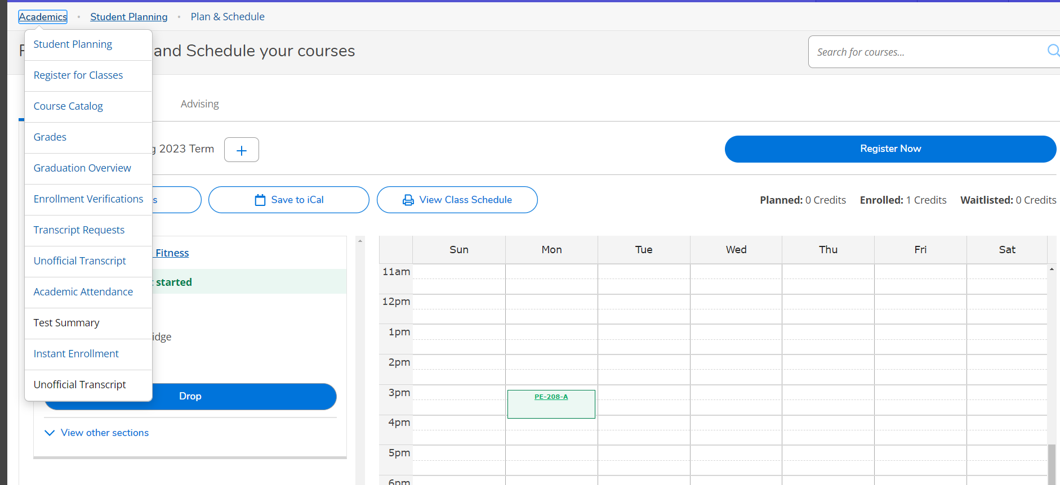
From the Academic Tab- Students can access Course Catalog for Registration

Slide 7
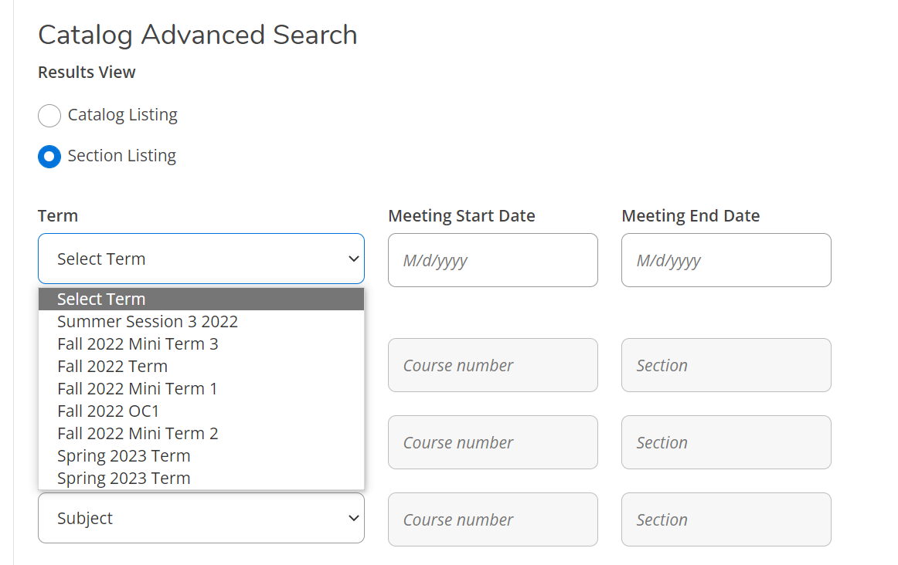
Select the Term in the Drop-Down Menu and select subjects to search available courses

Slide 8
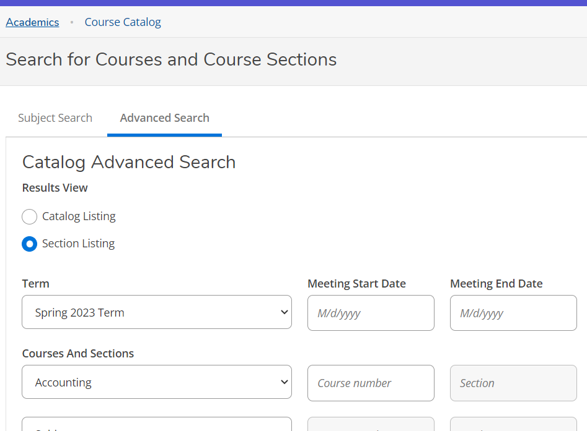
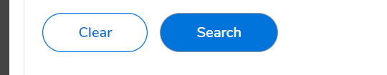
Once a Subject is selected- click search at the bottom of the page to view Courses

Slide 9
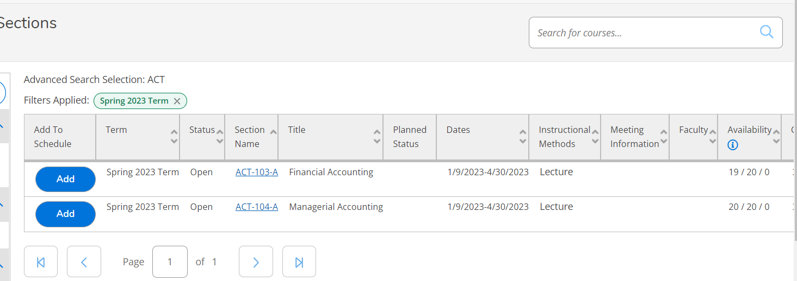
Click add to place a course on your student plan. Make sure to check availability for open seats. Repeat process for each additional course.
NOTE: This will only add the course to your plan.

Slide 10
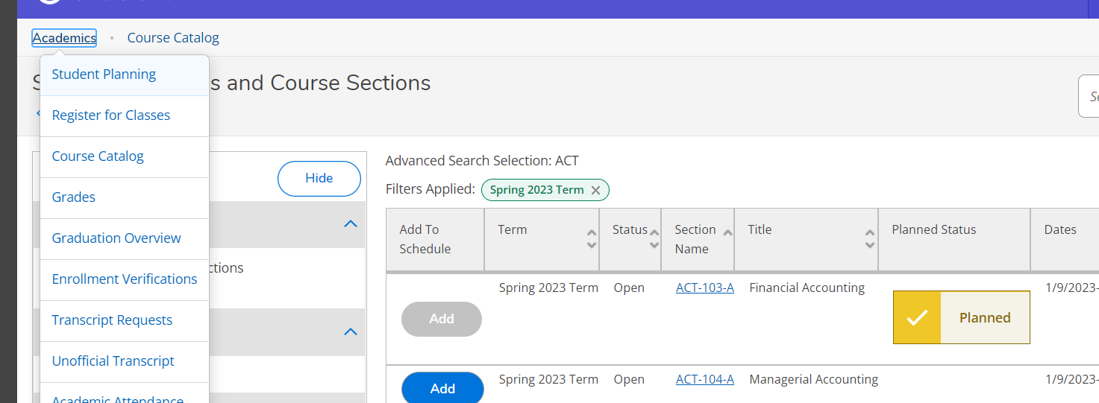
Once the courses are planned- Students will need to register for each course. Click on the link to Register for Classes

Slide 11
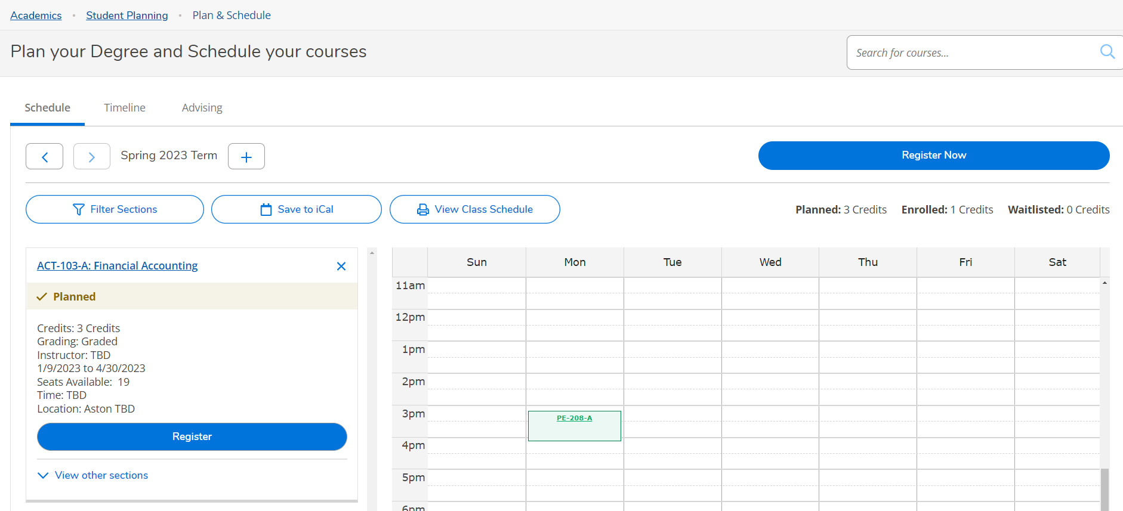
Click Register to add the course to your schedule. This screen can also be used to view and manage waitlisted courses.

Slide 12
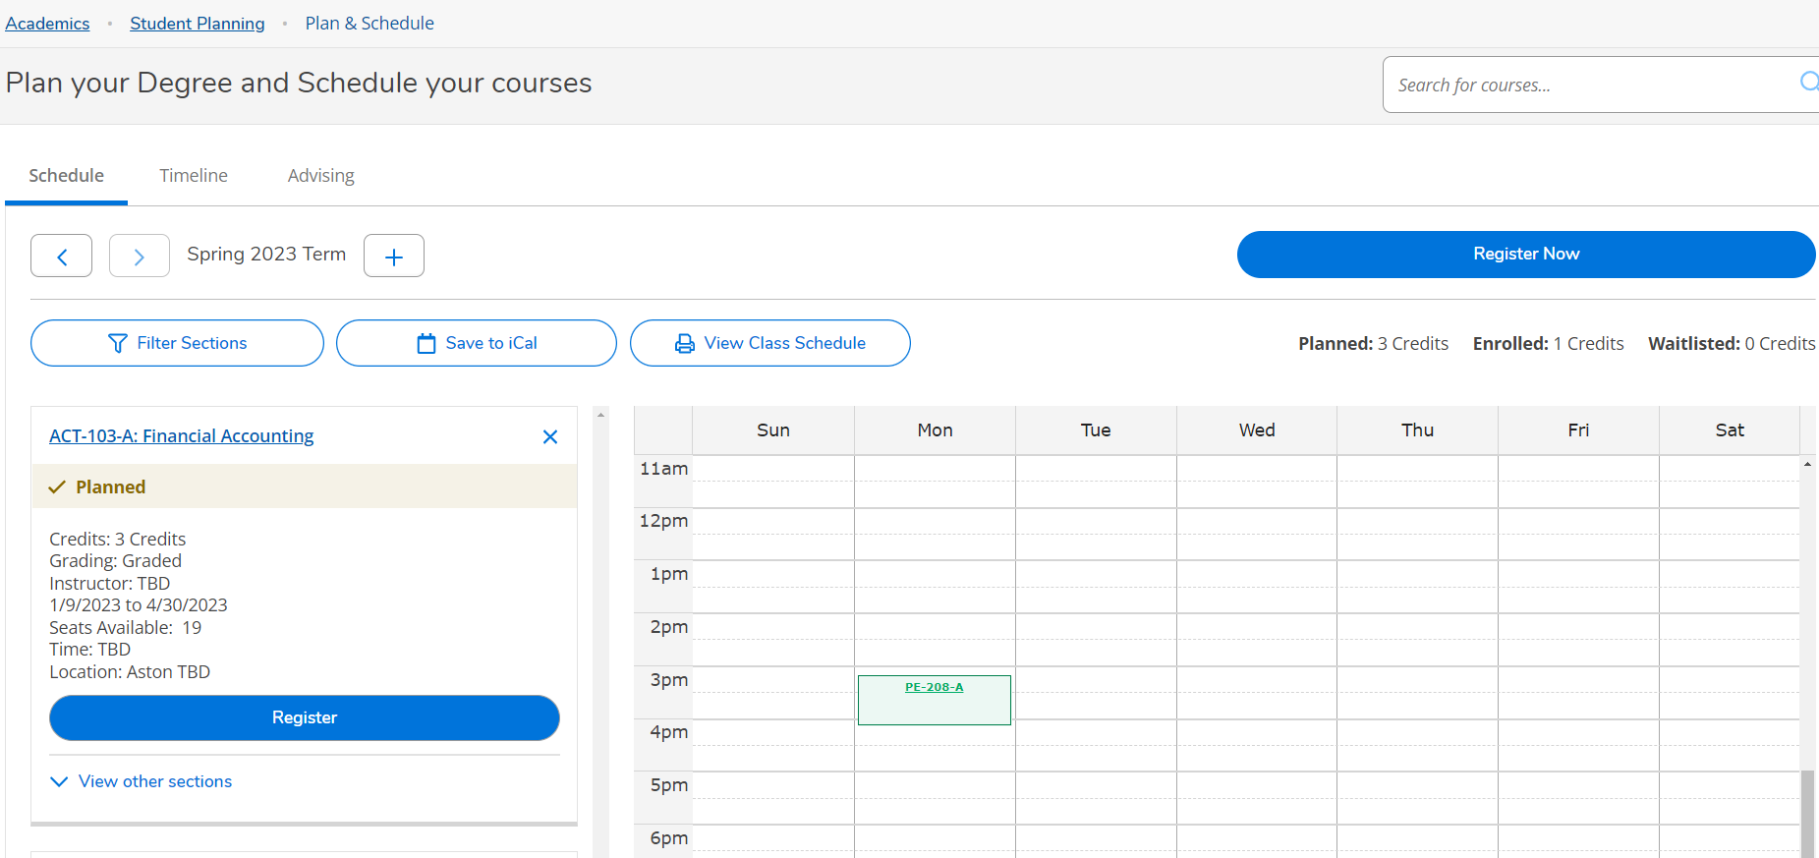
Once you click Register Now the course will show as enrolled credit- to confirm registration and view schedule- click on the View Class Schedule Button

Slide 13
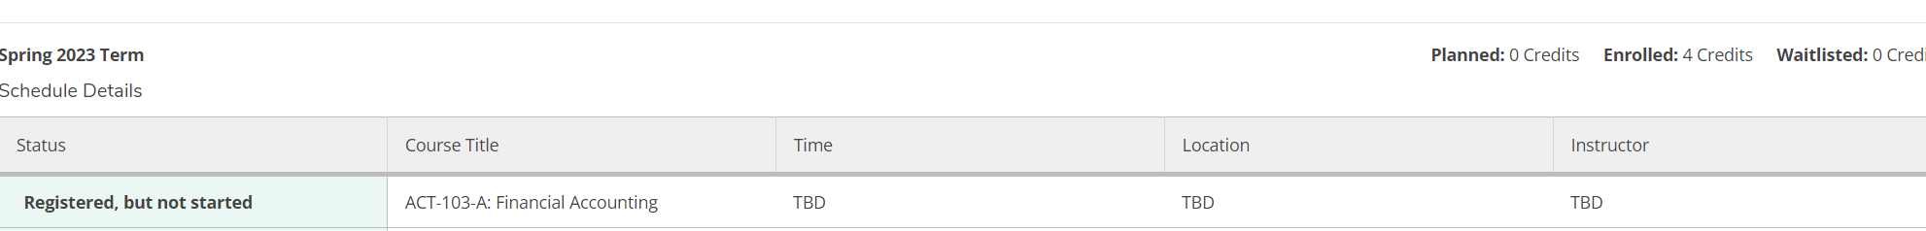
This is a view of your current schedule. Courses must show as Registered and enrolled- this is your confirmation that you are registered.
Please Note: Room assignments can change up the start of the term.
Please check your schedule regularly during the first week of class.
*
* When the course begins- Registered, but not started will change to the status of Registered

