Slide 1
TRiO
Student Support Services
Neumann University

Slide 2
Neumann TRIO
Student Support Services Program
  TRIO-SSS is federally funded under Title IV and managed by the Department of Education.
  More than 1,000 colleges and universities offer TRIO-SSS Programs in the United States.
  TRIO-SSS funds are obtained through a 5-year grant competition.
  Neumann University’s TRIO-SSS Program was awarded a 2025 grant!
  NU TRIO-SSS is one of fewer than 24 available in Pennsylvania!

Slide 3



Neumann TRIO
Student Support Services
  Neumann University’s TRIO-Student Support Services (SSS) Program helps students progress each semester and develop academically and personally to graduate and achieve success. The TRIO Program’s GOAL is to see our students remain in college, increase their GPA, and graduate with the least amount of debt possible.

Slide 4
Neumann TRIO
Student Support Services Program
  The MISSION of Neumann TRIO-SSS is very much in line with that of Neumann University and the RISES values. The program seeks to elevate and support SSS-eligible students who have been granted acceptance to Neumann University on their own merit and engaged in TRIO programming to enhance what they can achieve through their effort and education. Our belief is that learning empowers them with tools, possibilities, and economic mobility that our TRIO students may not have previously imagined possible. Once their goals have been reached, the TRIO program aims to elicit the support of our successful graduates to model for those who follow them in order that they might give back to others what they have learned.

Slide 5

Neumann TRIO
Student Support Services Program
Commitment to NU TRIO Students
One on One Counseling
Academic Support
Individualized Tutoring
Unique Programming
Early Class Registration
Course Selection Assistance
Financial Aid and Literacy Counseling
Help with Graduate School and Career Planning
Membership in a Legacy of TRIO Alumni

Slide 6
Neumann TRIO
Student Support Services Program
  Who is Eligible to Apply?
  US citizens or permanent residents eligible for federal loans or grants,
  students pursuing their first bachelor's degree, and
  freshman or sophomore students who are academically in need of services.
  Students must also be one or more of the following:
  income eligible as defined by the US Department of Health and Human Services Low-Income Guidelines;
  first-generation in the family to attend college/university with neither parent nor the parent/guardian with whom the student lived having graduated from a four-year college/university;
  approved for accommodations by Accessibility Services.

Slide 7
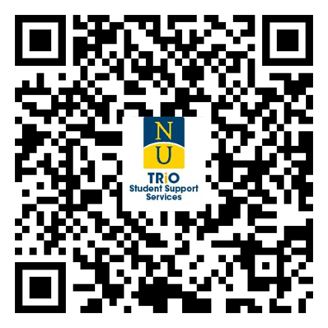
Neumann TRIO
Student Support Services
Apply for the
Neumann TRIO-SSS Program!
  The TRIO Program Application can be found on the Neumann University TRIO website and completed electronically through DocuSign.
  Separate applications are available for dependent and independent students.

Slide 8
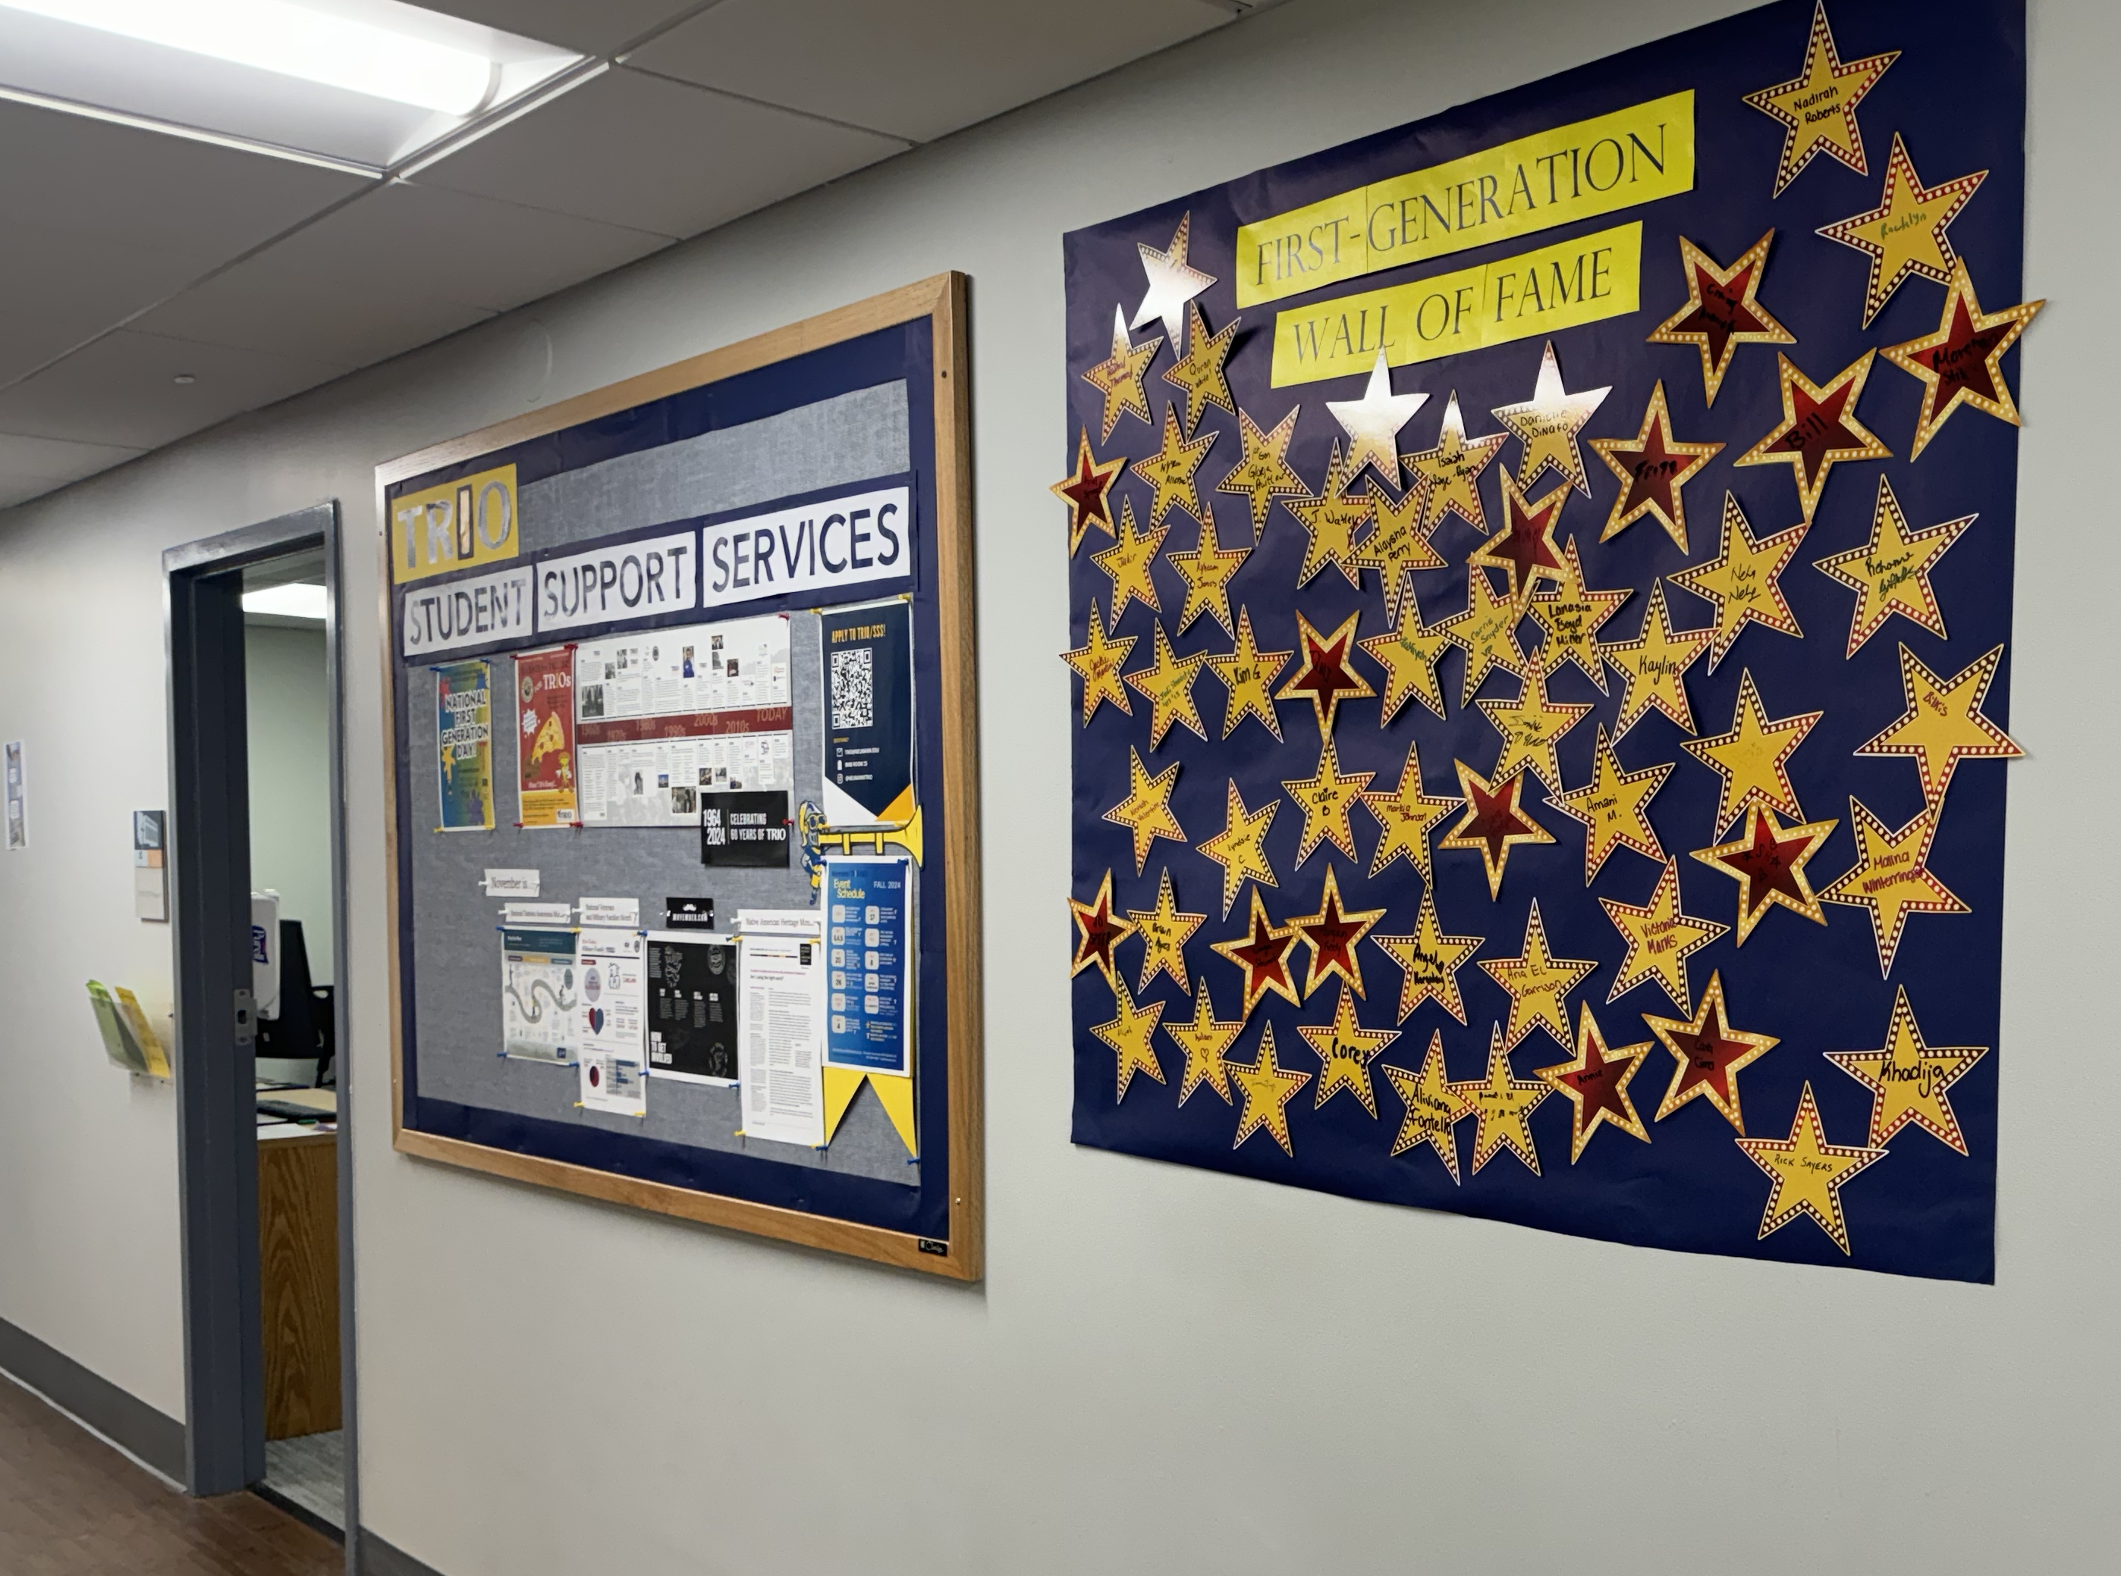
Neumann TRIO
Student Support Services Program
Scheduling an Interview
  Once the TRIO office receives a completed DocuSign application, the student is contacted by email to set up a virtual interview. Please be ready to provide some dates and times for the interview.

Slide 9

Neumann TRIO
Student Support Services
How Does TRIO Select Students?
With a limited number of acceptances, the TRIO-SSS Program staff will interview and select applicants based on eligibility criteria and the applicant’s intent to fully use the program’s services and to graduate.
Federal TRIO-SSS Grant Regulations assign priority to full-time students who are:
    incoming freshmen and sophomores who are either income-eligible, first generation, or both;
    incoming freshmen and sophomores who are approved for accommodations.

Slide 10

Neumann TRIO
Student Support Services
What are Neumann TRIO-SSS Students Saying About the Program?
“TRIO encouraged me to pursue short term goals which enhanced my long-term vision. I also gained organizational advice that helped reduce my stress load.”
“TRIO made me a better student by making me more confident in my ability to succeed.”
“It has impacted me well as I received a different perspective for life obstacles.”
“TRIO is concerned for its students and wants to see them succeed. TRIO wants the best out of its members.”
Comments offered by students and alumni via anonymous survey

